Slide 1
Detection of Esophageal Sample via PANORAMA

Slide 2
Specifications
Sample used: 307-388A, 307-400A, 307-454A, 307-456A, 307-406A, 307-417A, 307-428A, 307-466A, 307-474A, 307-410A, 307-471A
Antibody for capture: CD9, CD63, CD81
Concentration used: Unknown
Size Distribution: Unknown
Volume used: 20 µl
Experiment duration: 60 minutes

Slide 3
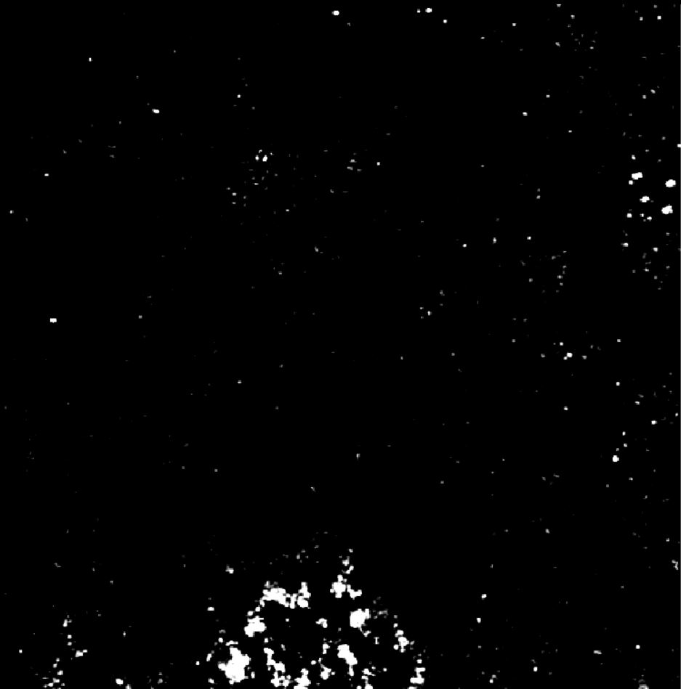

Image of Detected Particles via PANORAMA (307-388A)
Before Wash
Number of Particles detected: 250
Number of Exosomes detected: 233
After Wash
Number of Particles detected: 108
Note: 0 % response to miRNA-21
Look cancerous
Scale Bar: 10 µm

Slide 4
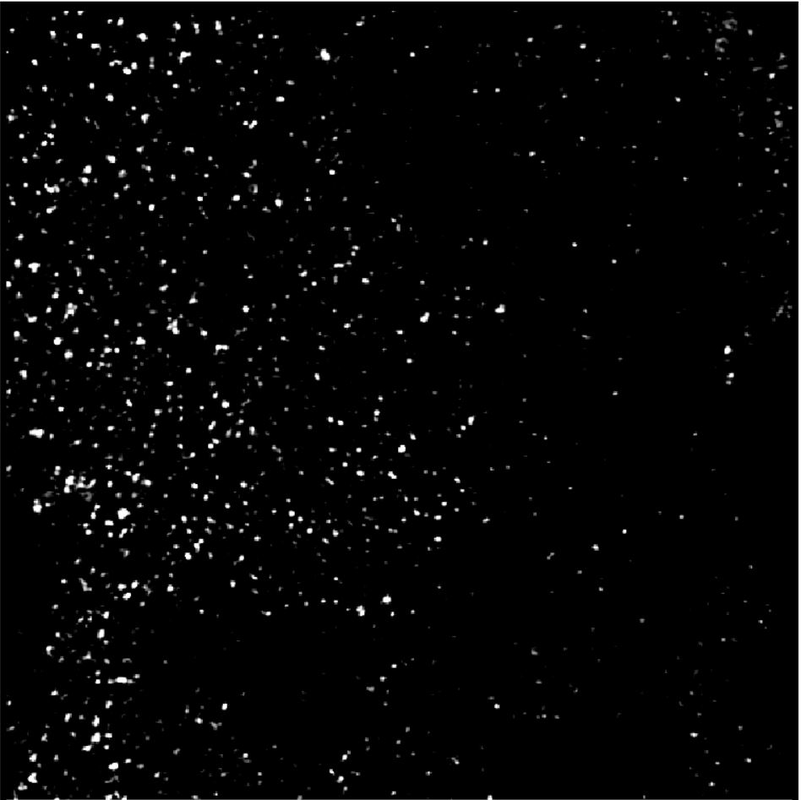
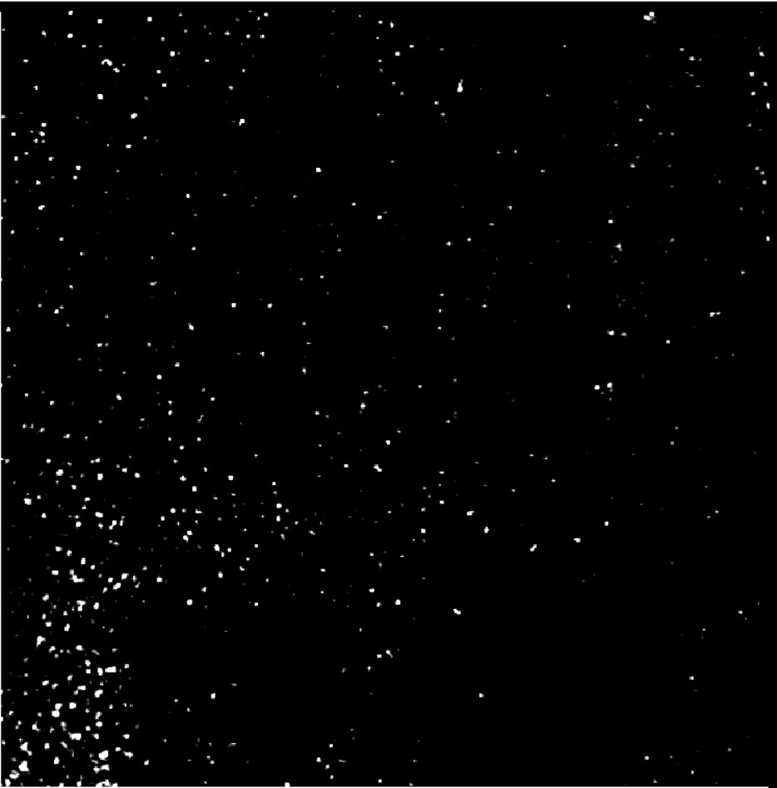
Image of Detected Particles via PANORAMA (307-400A)
Before Wash
Number of Particles detected: 581
Number of Exosomes detected: 518
After Wash
Number of Particles detected: 468
Note: 0 % response to miRNA-21
Look cancerous
Scale Bar: 10 µm

Slide 5
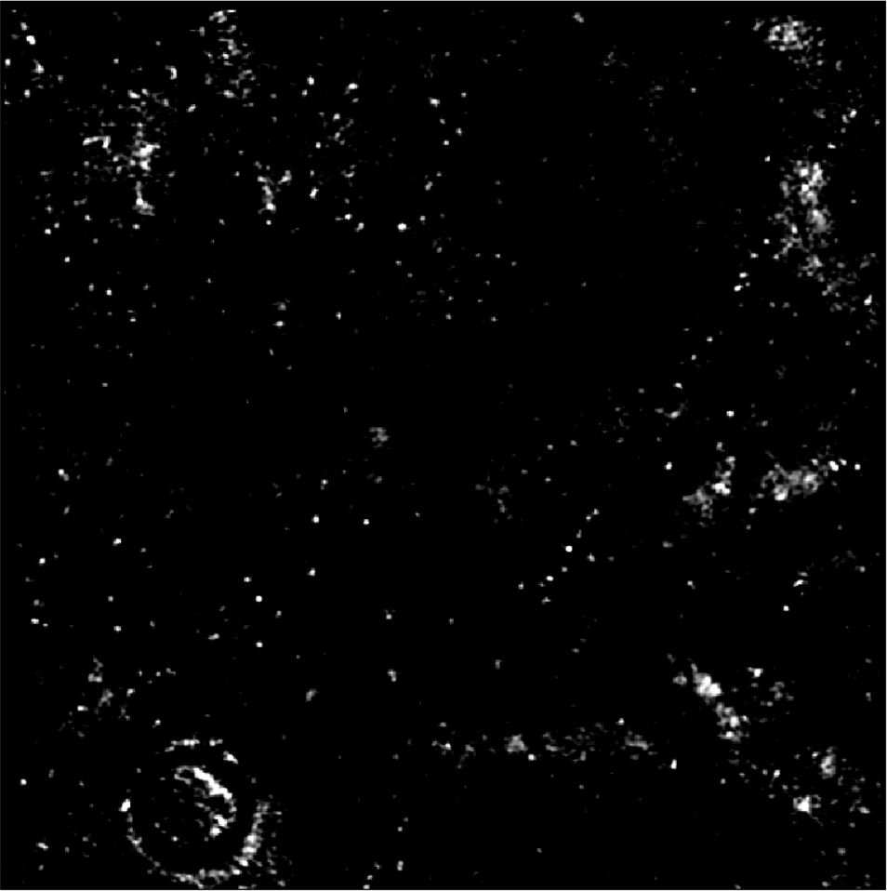
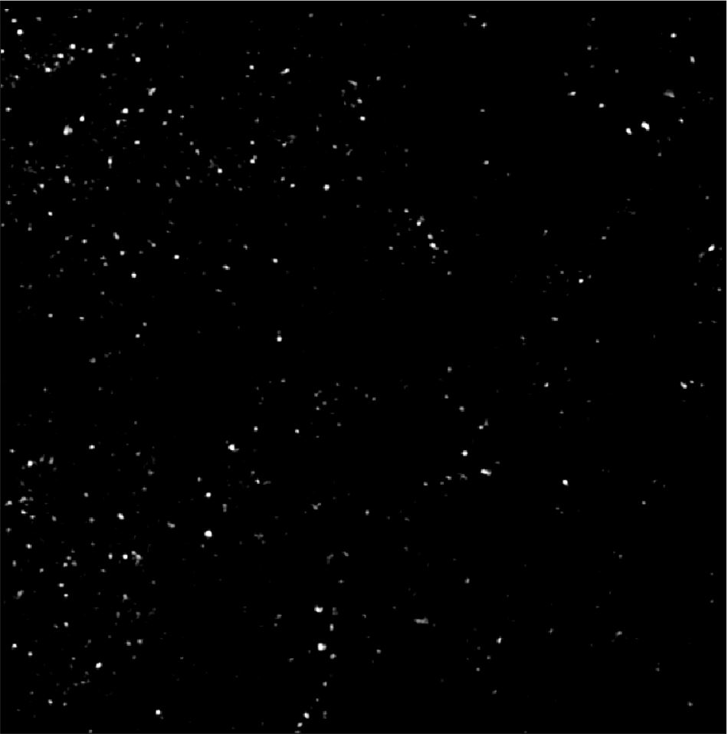
Image of Detected Particles via PANORAMA (307-454A)
Before Wash
Number of Particles detected: 468
Number of Exosomes detected: 418
After Wash
Number of Particles detected: 390
Note: 0 % response to miRNA-21
Look cancerous
Scale Bar: 10 µm

Slide 6
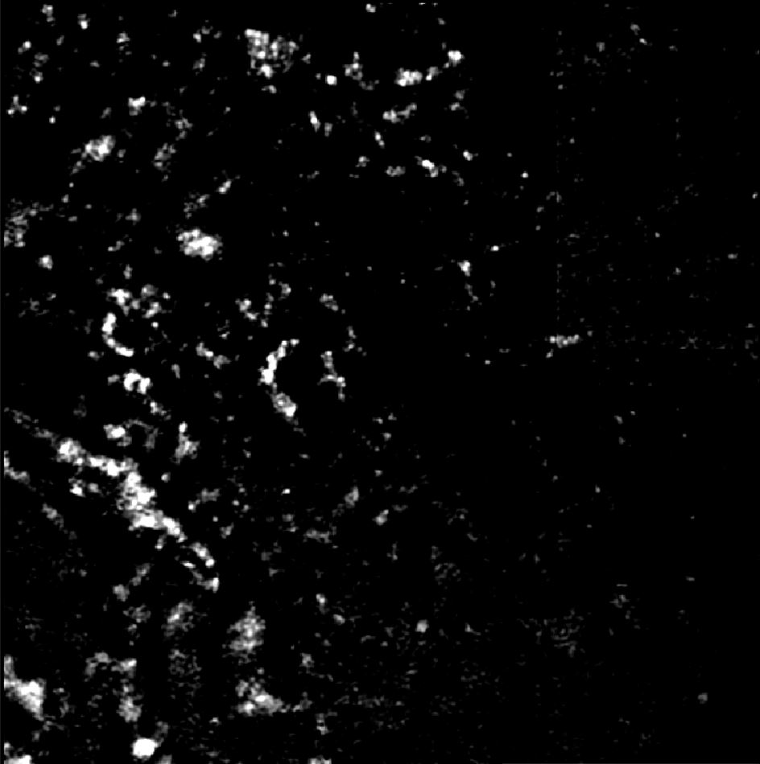
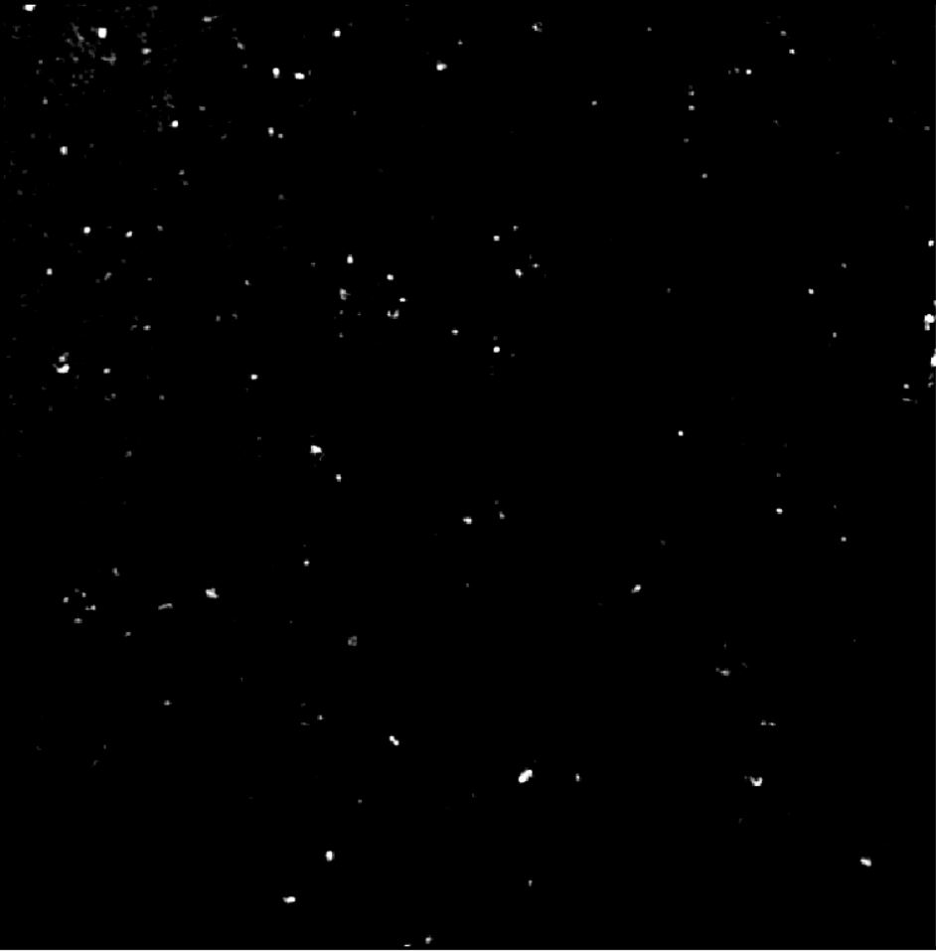
Image of Detected Particles via PANORAMA (307-456A)
Before Wash
Number of Particles detected: 413
Number of Exosomes detected: 283
After Wash
Number of Particles detected: 143
Note: 0 % response to miRNA-21
Look cancerous
Scale Bar: 10 µm

Slide 7
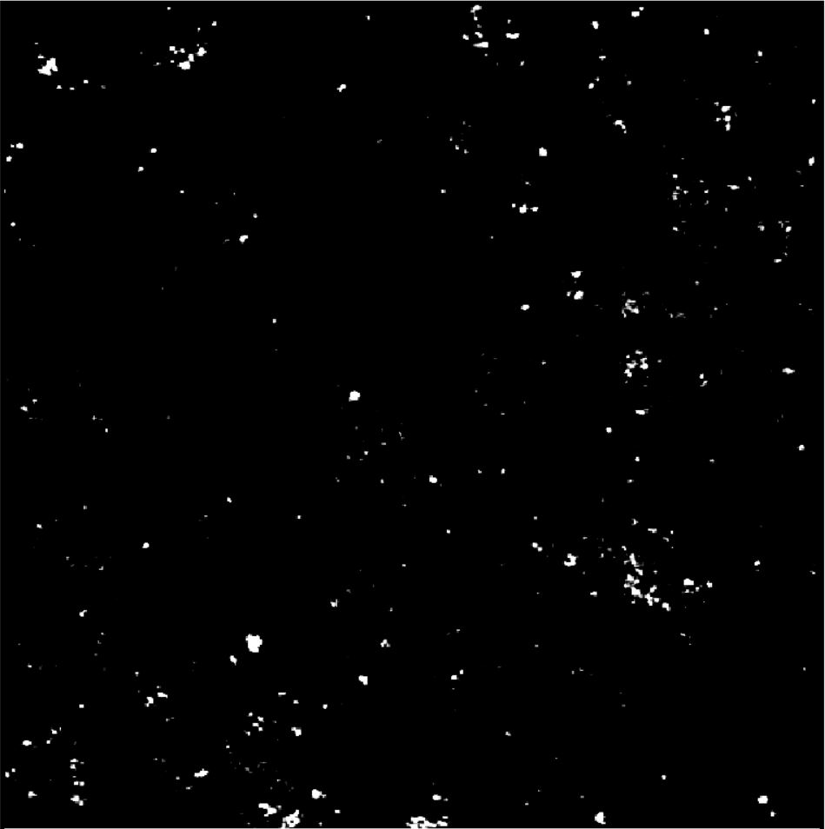
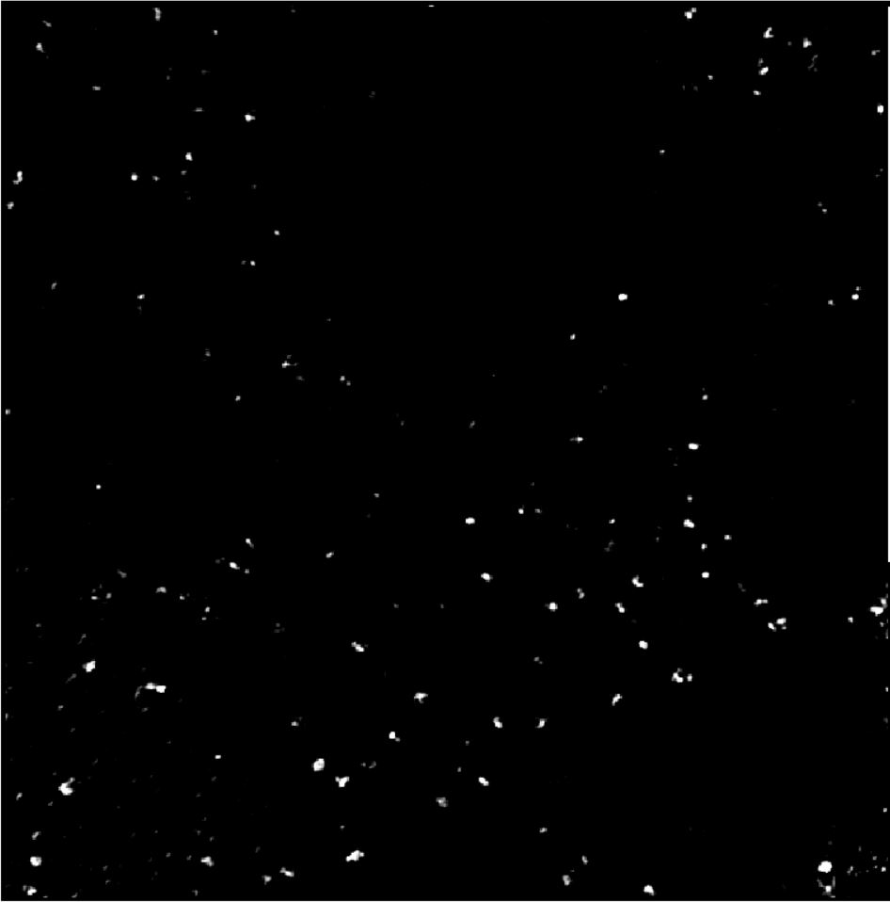
Image of Detected Particles via PANORAMA (307-406A)
Before Wash
Number of Particles detected: 367
Number of Exosomes detected: 343
After Wash
Number of Exosomes Retained: 187
Note: 0 % response to miRNA-21
Look cancerous
Scale Bar: 10 µm

Slide 8
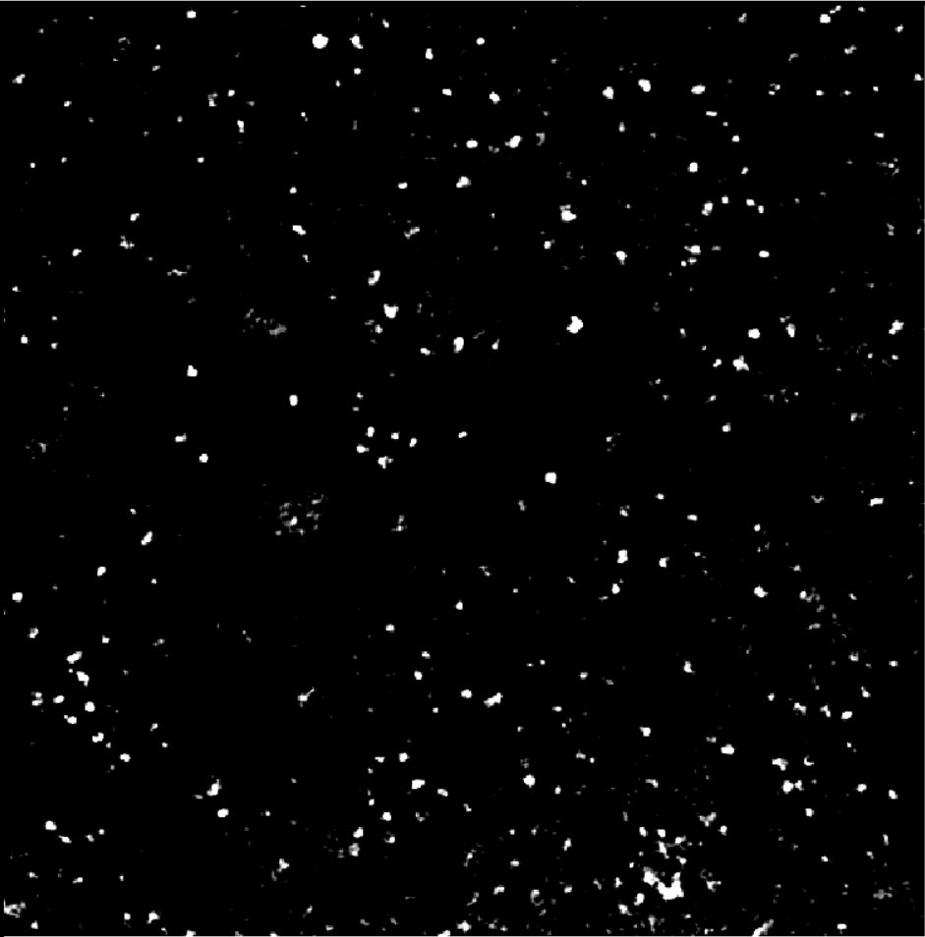
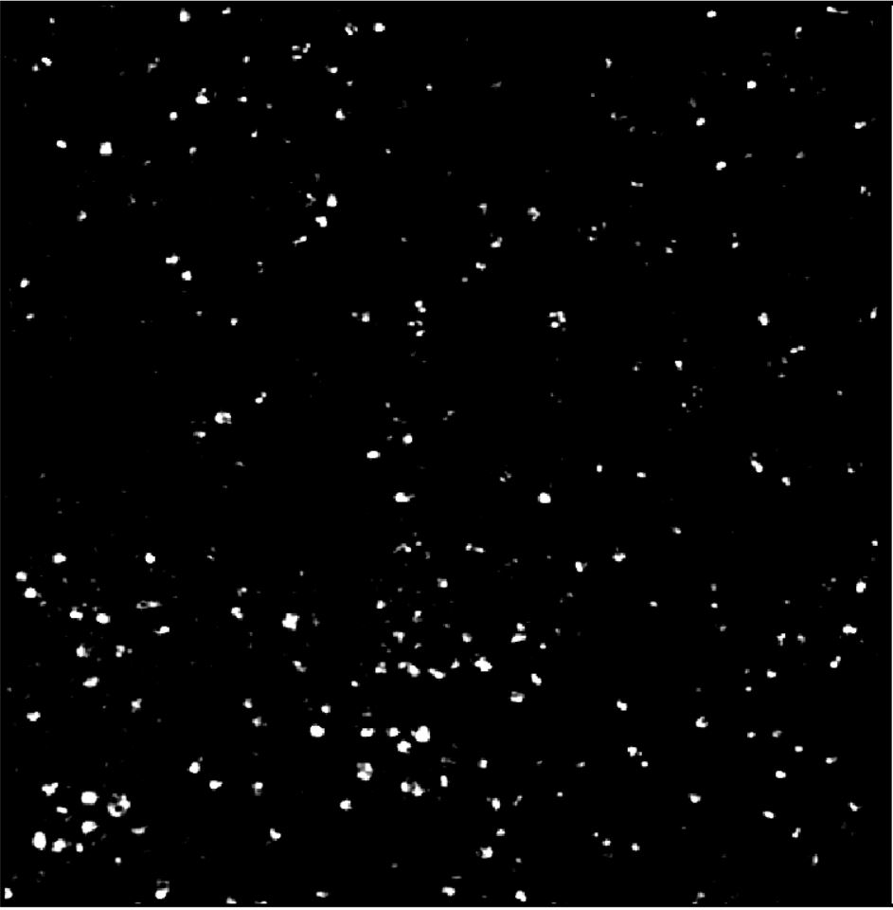
Image of Detected Particles via PANORAMA (307-417A)
Before Wash
Number of Particles detected: 359
Number of Exosomes detected: 333
After Wash
Number of Exosomes Retained: 255
Note: 0 % response to miRNA-21
Look cancerous
Scale Bar: 10 µm

Slide 9
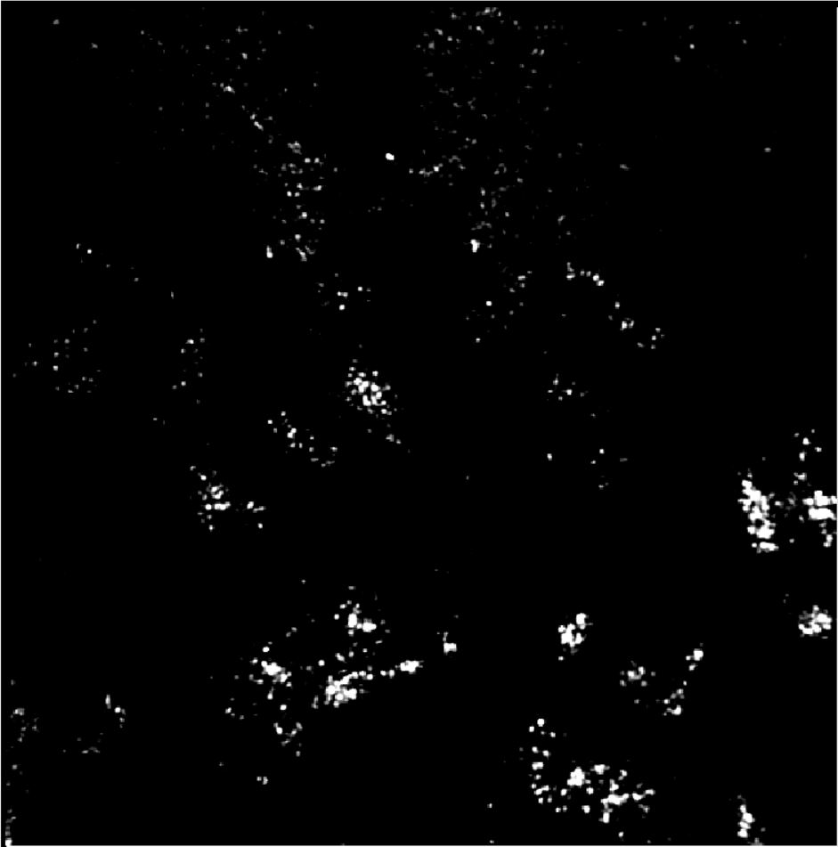
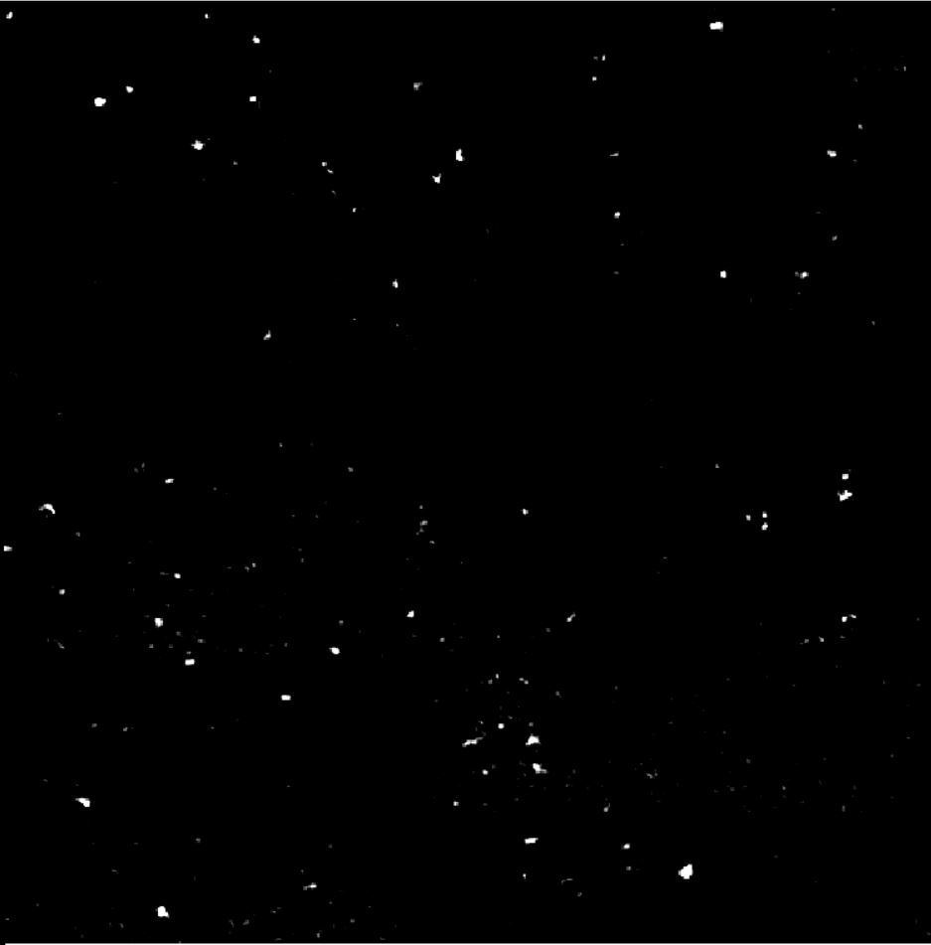
Image of Detected Particles via PANORAMA (307-428A)
Before Wash
Number of Particles detected: 251
Number of Exosomes detected: 169
After Wash
Number of Exosomes Retained: 111
Note: 0 % response to miRNA-21
Look cancerous
Scale Bar: 10 µm

Slide 10
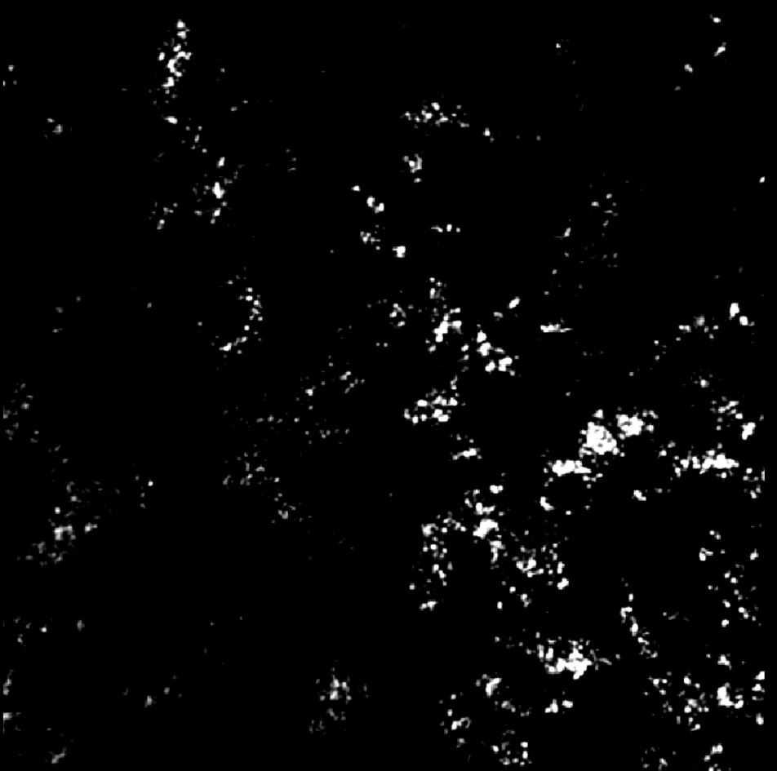
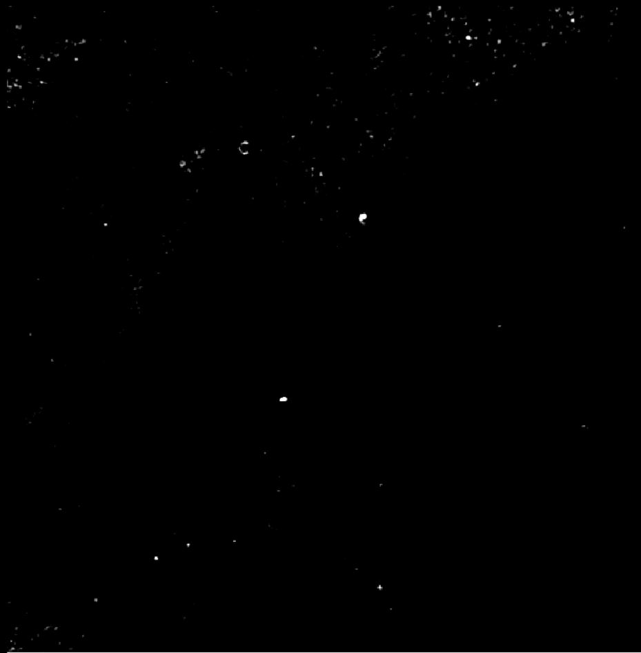
Image of Detected Particles via PANORAMA (307-466A)
Before Wash
Number of Particles detected: 277
Number of Exosomes detected: 174
After Wash
Number of Exosomes Retained: 74
Note: 0 % response to miRNA-21
Look cancerous
Scale Bar: 10 µm

Slide 11
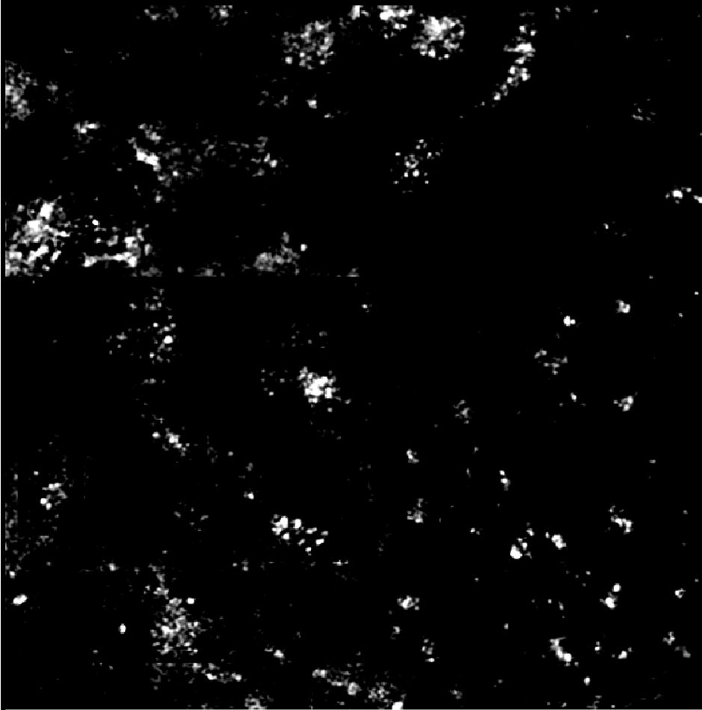
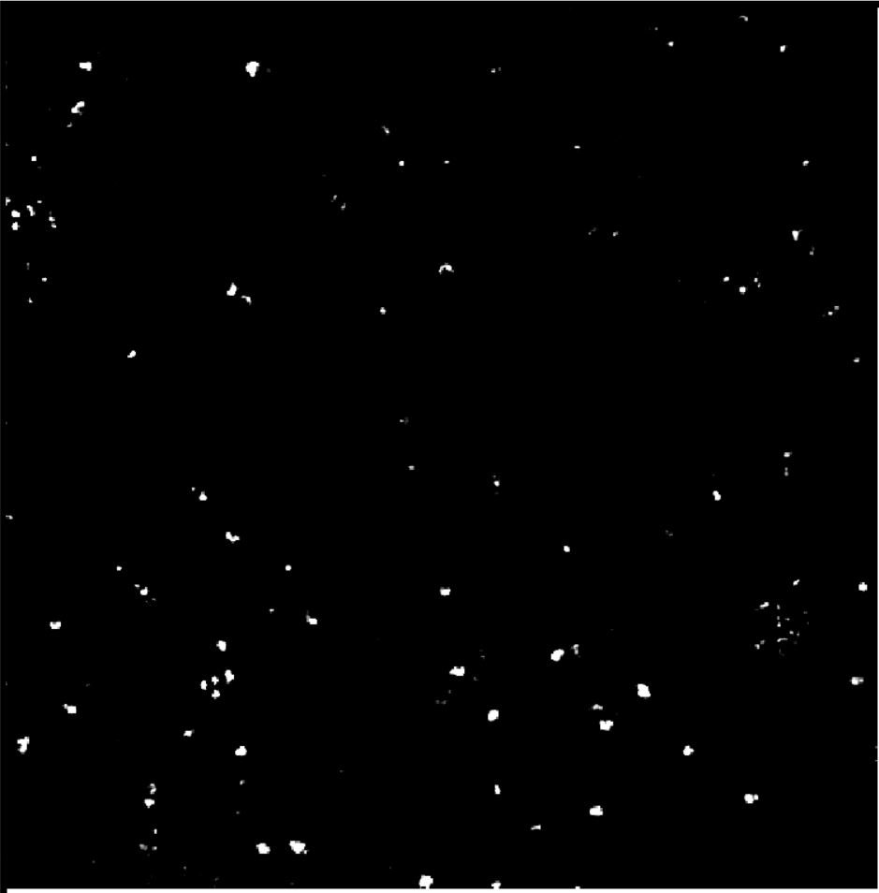
Image of Detected Particles via PANORAMA (307-474A)
Before Wash
Number of Particles detected: 304
Number of Exosomes detected: 227
After Wash
Number of Exosomes Retained: 153
Note: 0 % response to miRNA-21
Look cancerous
Scale Bar: 10 µm

Slide 12
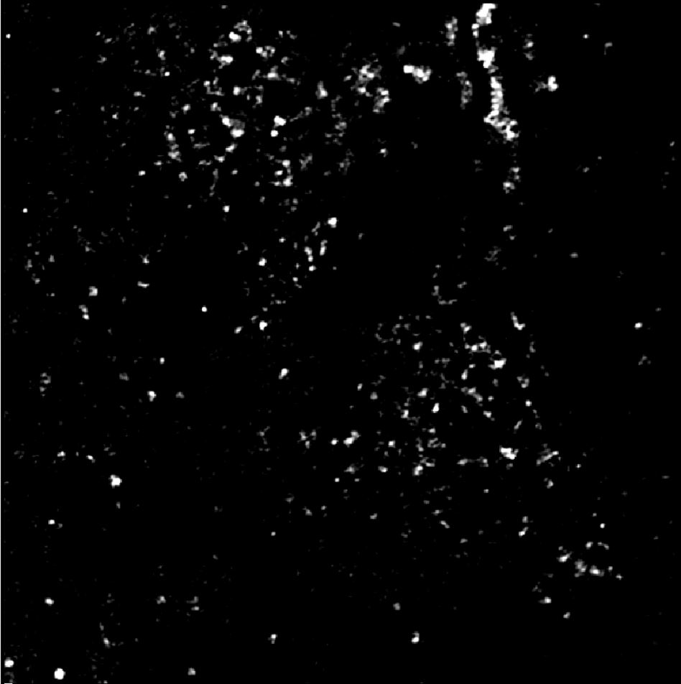
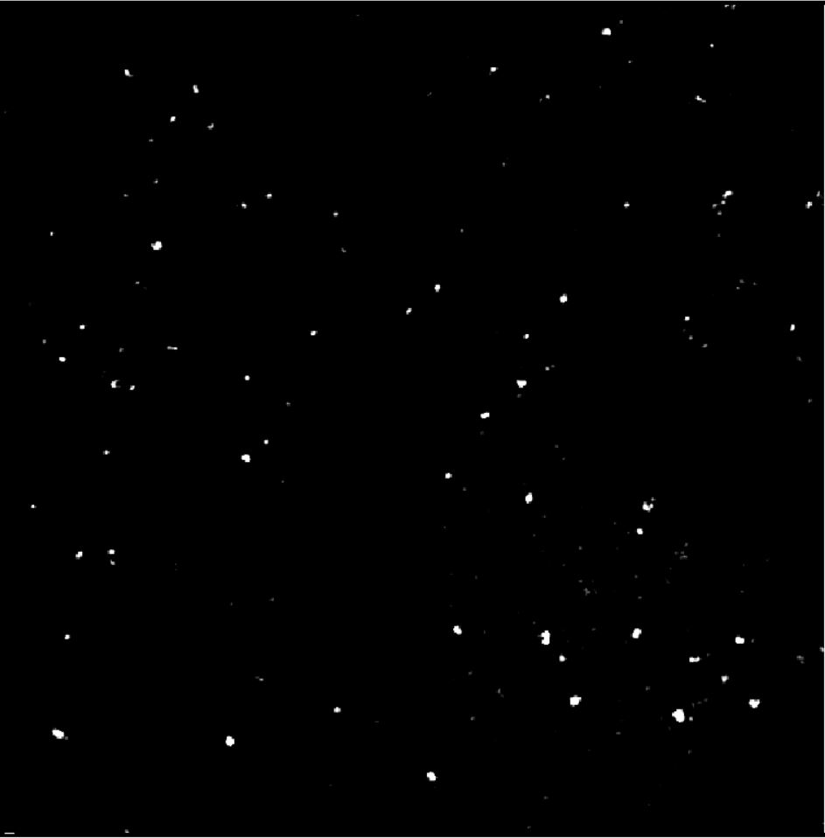
Image of Detected Particles via PANORAMA (307-410A)
Before Wash
Number of Particles detected: 368
Number of Exosomes detected: 301
After Wash
Number of Exosomes Retained: 151
Note: 0 % response to miRNA-21
Look cancerous
Scale Bar: 10 µm

Slide 13
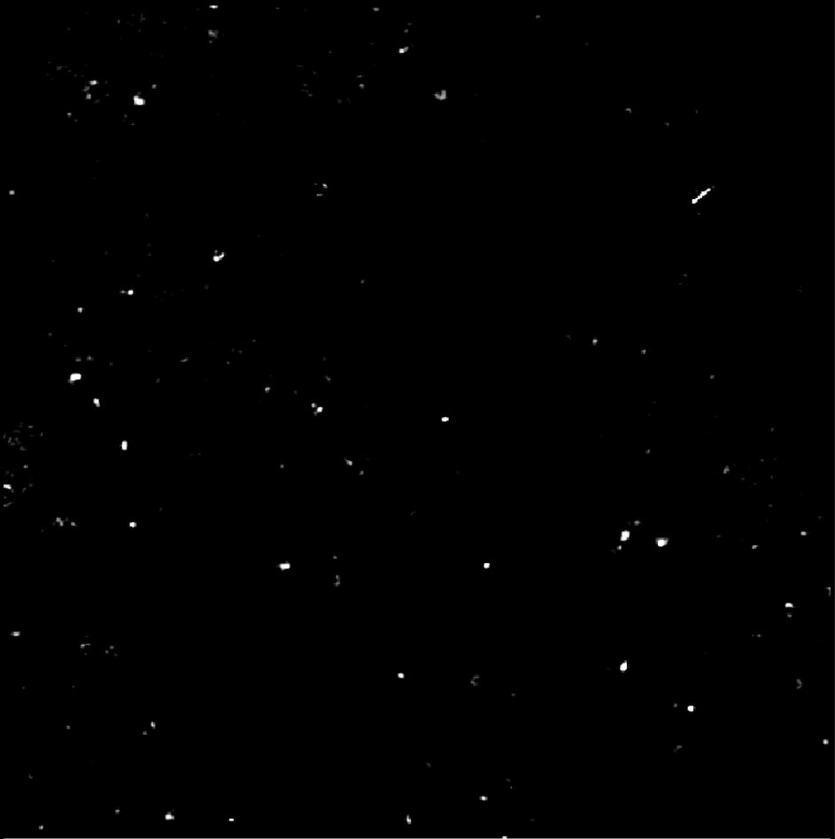
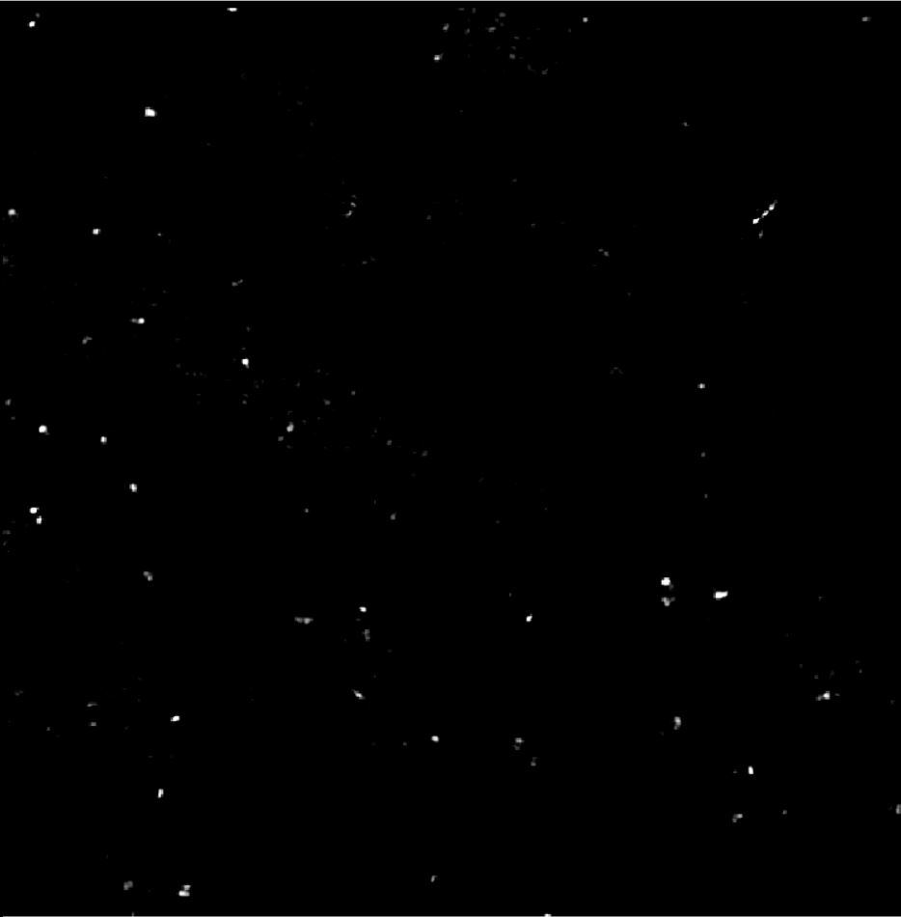
Image of Detected Particles via PANORAMA (307-471A)
Before Wash
Number of Particles detected: 189
Number of Exosomes detected: 177
After Wash
Number of Exosomes Retained: 108
Note: 0 % response to miRNA-21
Look cancerous
Scale Bar: 10 µm

Slide 14
Summary of Particle Count
Healthy Plasma Exosome Range is [5-40]
Sample Name | Before Wash Count (Total Particles) | Before Wash Count (Large Particles) | Before Wash Count (Exosomes) | After Wash Count | Retention Rate[Retained exosomes/Total Particles] (%) | Retention Rate[Retained exosomes/Total exosomes] (%)
0307-389A | 1207 | 17 | 1190 | 1089 | 90.22 | 91.5
0307-397A | 429 | 200 | 229 | 82 | 19.11 | 35.8
0307-353A | 383 | 50 | 333 | 115 | 30.03 | 34.5
0307-354A | 411 | 106 | 305 | 229 | 55.7 | 75
0307-371A | 516 | 180 | 336 | 253 | 49.03 | 75.3
0307-434A | 846 | 234 | 612 | 237 | 28 | 38.7
0307-440A | 1105 | 508 | 597 | 131 | 11.85 | 22
0307-447A | 405 | 179 | 226 | 105 | 25.92 | 46.5
0307-451A | 266 | 54 | 212 | 161 | 60.52 | 75.9
0307-388A | 250 | 17 | 233 | 108 | 43.2 | 46.3
0307-400A | 581 | 63 | 518 | 468 | 80.6 | 90.3
0307-454A | 468 | 50 | 418 | 390 | 83.3 | 93.3
0307-456A | 413 | 130 | 283 | 143 | 34.6 | 50.5
0307-406A | 367 | 24 | 343 | 187 | 50.9 | 54.5
0307-417A | 359 | 26 | 333 | 255 | 71 | 76.5
0307-428A | 251 | 82 | 169 | 111 | 44.2 | 65.7
0307-466A | 277 | 103 | 174 | 74 | 26.7 | 42.5
0307-474A | 304 | 77 | 227 | 153 | 50.3 | 67.4
0307-410A | 368 | 67 | 301 | 151 | 41.14 | 50.16
0307-471A | 189 | 12 | 177 | 108 | 57.14 | 61

